Slide 1
How far can we get in one week?
The struggeling, the improvement and the result of the first week.

Slide 2
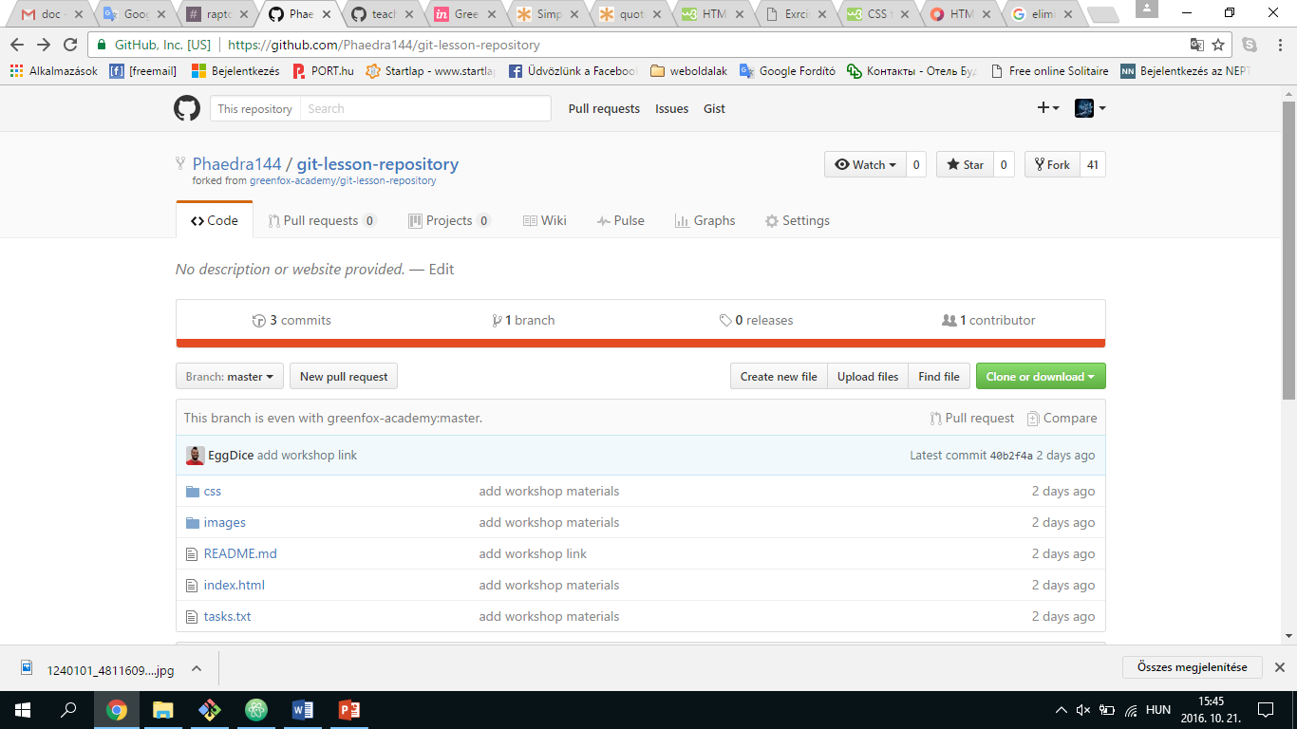
First impressions of
GITHUB

Slide 3
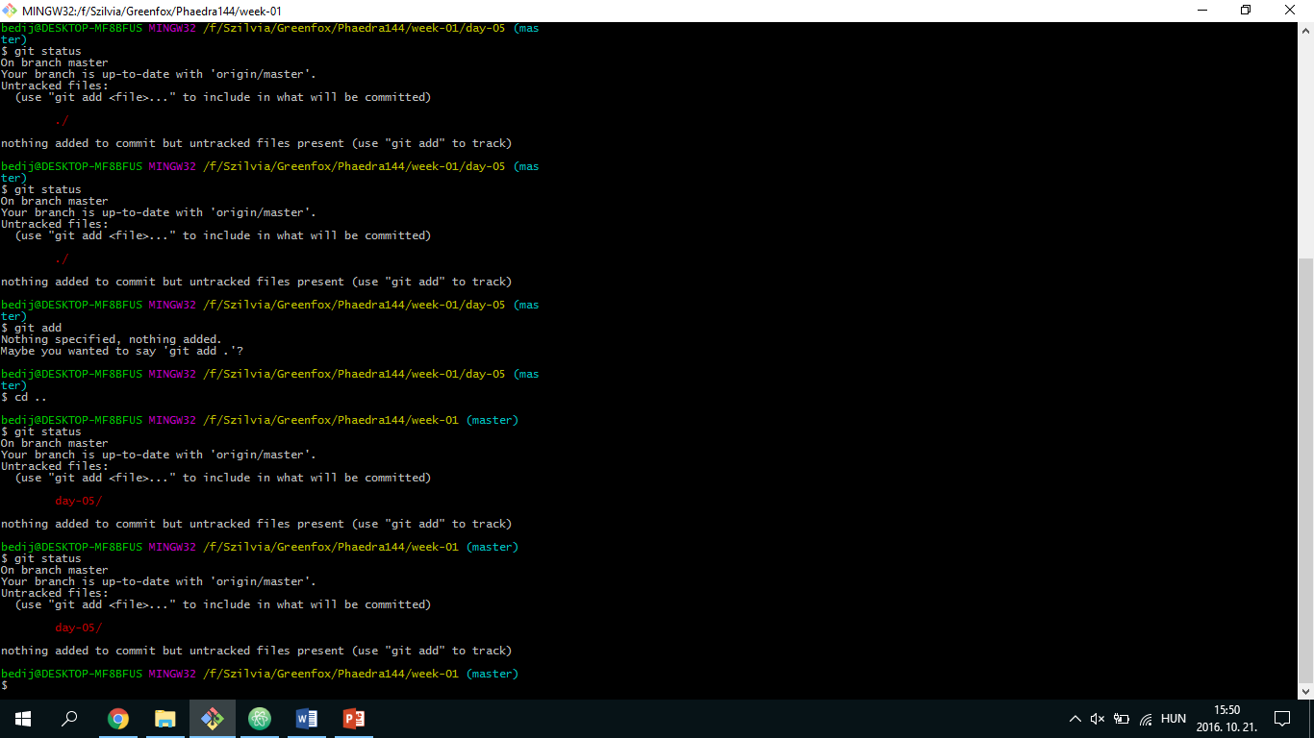
First impressions of
Command lines

Slide 4
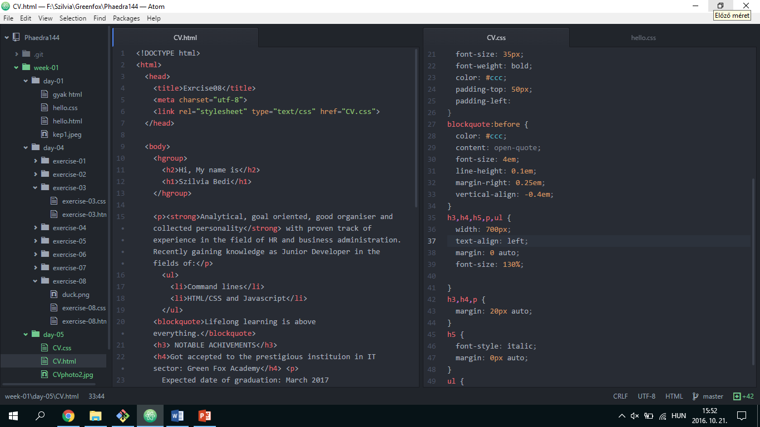
First impressions of
HTML/CSS

Slide 5
